Slide 1
Are repetitive RNAs differentially expressed in quiescent cells?
Humza Ashraf, Rachel Bowyer, Evan Lester
12/8/2019
Notes:
Rachel will do this slide

Slide 2

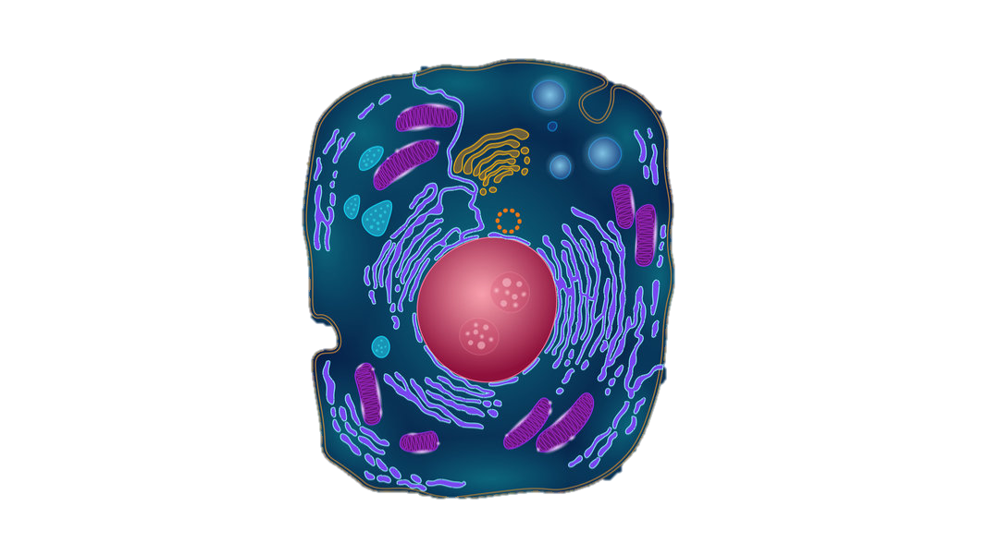
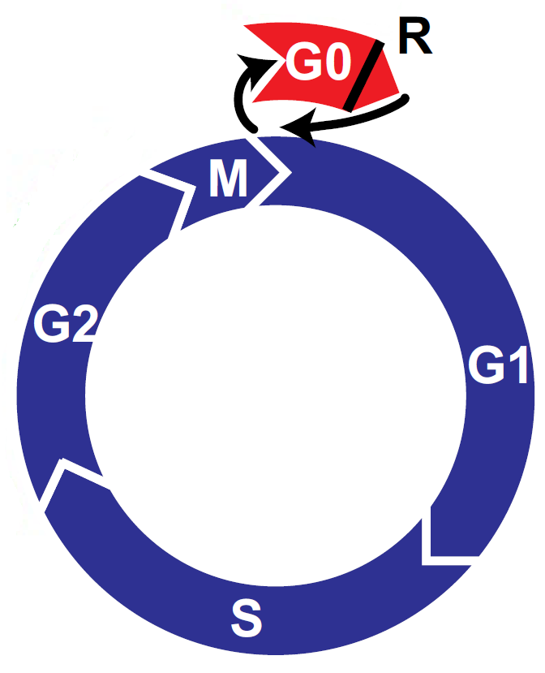
What is a Quiescent Cell? Why do we care about them?
A quiescent cell that has exited the cell cycle (i.e., not dividing)
Considered to be in the G0 phase
Quiescent cells are not dead, they can re-enter the cell cycle and start dividing again
Adult stem cells are mostly in quiescence, 90% of adult hemopoietic stem cells (HSC), compared to 0.02% of foetal HSC
Notes:
Rachel will do this slide

Slide 3
What causes Quiescence?
There are different things that can trigger quiescence:
Spontaneous quiescence
Nutrient deprivation
Stress
Other extrinsic signals (known and unknown)
What do these causes have in common? Specifically in terms of gene counts?
Big goals of understand the specific mechanics of quiescence
develop a targeted way to active quiescence cells - cancer treatment
develop a targeted way to reactivate quiescent cells - faster healing of injuries, also cancer treatment
Notes:
Rachel will do this slide

Slide 4
Goal: Determine if there are specific repetitive RNA elements that are differentially expressed in quiescent cells
Notes:
_____ will do this slide

Slide 5
Goal: Determine if there are specific repetitive RNA elements that are differentially expressed in quiescent cells
Approach: Reanalyze RNAseq data using RepEnrich to look for differences in specific repetitive sequences in cycling vs quiescent cells
Notes:
_____ will do this slide

Slide 6
Goal: Determine if there are specific repetitive RNA elements that are differentially expressed in quiescent cells
Approach: Reanalyze RNAseq data using RepEnrich to look for differences in specific repetitive sequences in cycling vs quiescent cells
Why?
A universal quiescence marker could be diagnostically useful for enhancing the efficacy of current cancer therapies
Repetitive elements are missed by standard RNAseq mapping programs
Transposable elements are known to increase with age. Does this happen in spontaneously quiescent cells in culture?
Notes:
_____ will do this slide

Slide 7
Goal: Determine if there are specific repetitive RNA elements that are differentially expressed in quiescent cells
Approach: Reanalyze RNAseq data using RepEnrich to look for differences in specific repetitive sequences in cycling vs quiescent cells
What did we find?
0 genes were consistent between all methods of inducing quiescence
5 differentially expressed genes in MEKi
7 differentially expressed genes in serum starvation
One overlapping gene between MEKi and serum starvation (MamGypLTR1b an endogenous retrovirus)
Notes:
_____ will do this slide

Slide 8
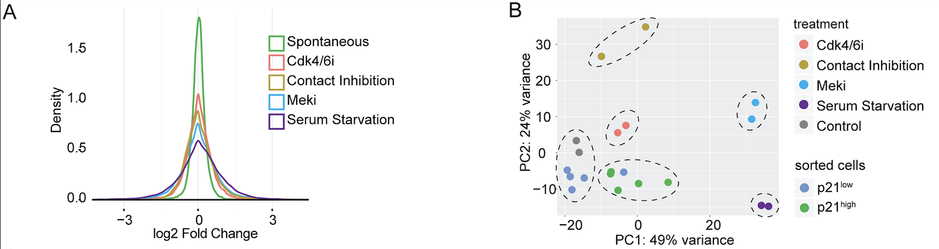
Dataset: experimental design (40 samples)
Min, Mingwei, and Sabrina L. Spencer. “Spontaneously Slow-Cycling Subpopulations of Human Cells Originate from Activation of Stress-Response Pathways.” PLOS Biology 17, no. 3 (March 13, 2019): e3000178. https://doi.org/10.1371/journal.pbio.3000178.

Slide 9
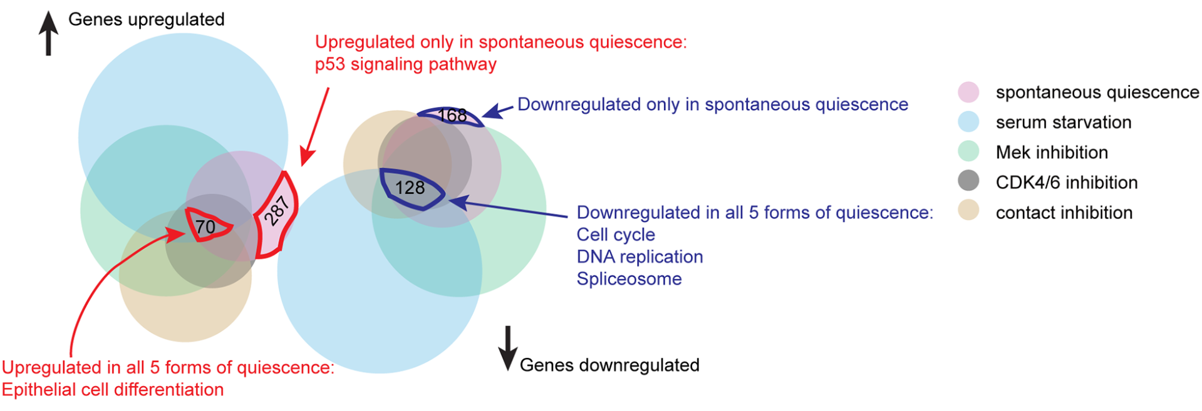
Are there certain RNAs upregulated in Quiescent cells
relative to cycling cells?
Previous work has only looked unique mapping RNAs.
Min & Spencer 2019
Notes:
_____ will do this slide

Slide 10
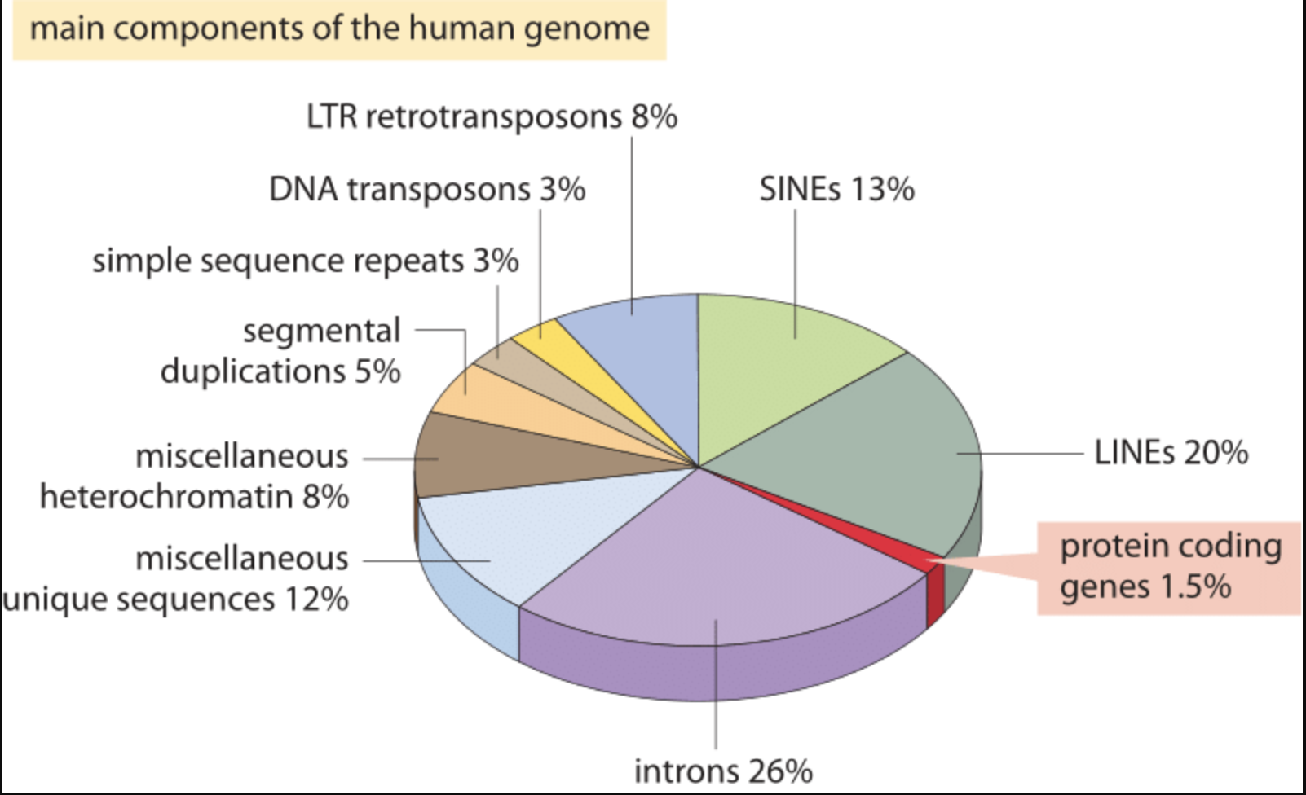
A large percentage of the human genome is made up of repetitive elements
- In fly models, transcription of many repetitive sequences increase with age.
- Does this happen in cell culture?
Adapted from T. R. Gregory Nat Rev Genet. 9:699-708, 2005 based on International Human Genome Sequencing Consortium. Initial sequencing and analysis of the human genome. Nature 409:860 2001.
Notes:
_____ will do this slide

Slide 11
How can we measure the abundance of repetitive elements?
Notes:
_____ will do this slide

Slide 12

Unique Mapping RNA fragment
Genome
RNA Fragment
Notes:
_____ will do this slide

Slide 13

Unique Mapping RNA fragment
Genome
RNA Fragment
Multimapping RNA fragment
Genome
RNA Fragment
Notes:
_____ will do this slide

Slide 14
Why are repetitive sequences missed by standard mapping software?
Two reasons:
Standard mapping programs, such as Hisat2, will only report 5 unique mappings per fragment (by default to decrease run time)
The reference genomes used to map RNAs are not annotated with repetitive elements
RepEnrich
Uses a reference genome made up of repetitive elements (GIRI RepBase)
Makes a separate reference genome for each repetitive element
maps to these independent genomes and keeps all multimappers
Notes:
_____ will do this slide

Slide 15

Analysis pipeline
Build reference files for
each repetitive element (python)
Raw sequencing data
Trim adapters/QC filter (Trimmomatic)
Repetitive Element
Reference
Trimmed reads
Align reads to reference
(allow multimapping)
Aligned reads
Quantify reads per repetitive element (RepEnrich, python)
Reads per repetitive element
Generate Comparisons
Differential expression (DEseq, R)
Up and downregulated
elements

Slide 16
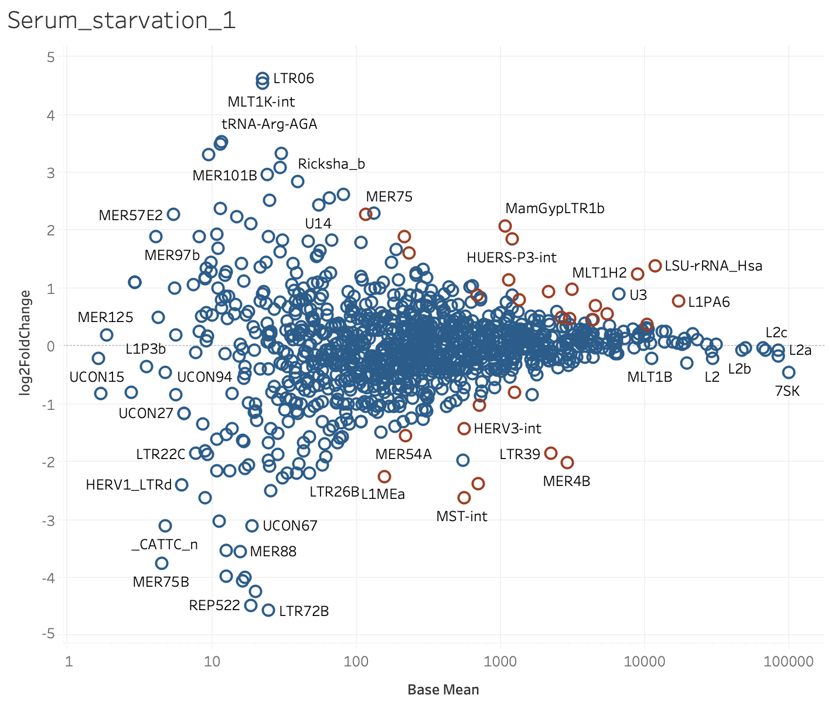
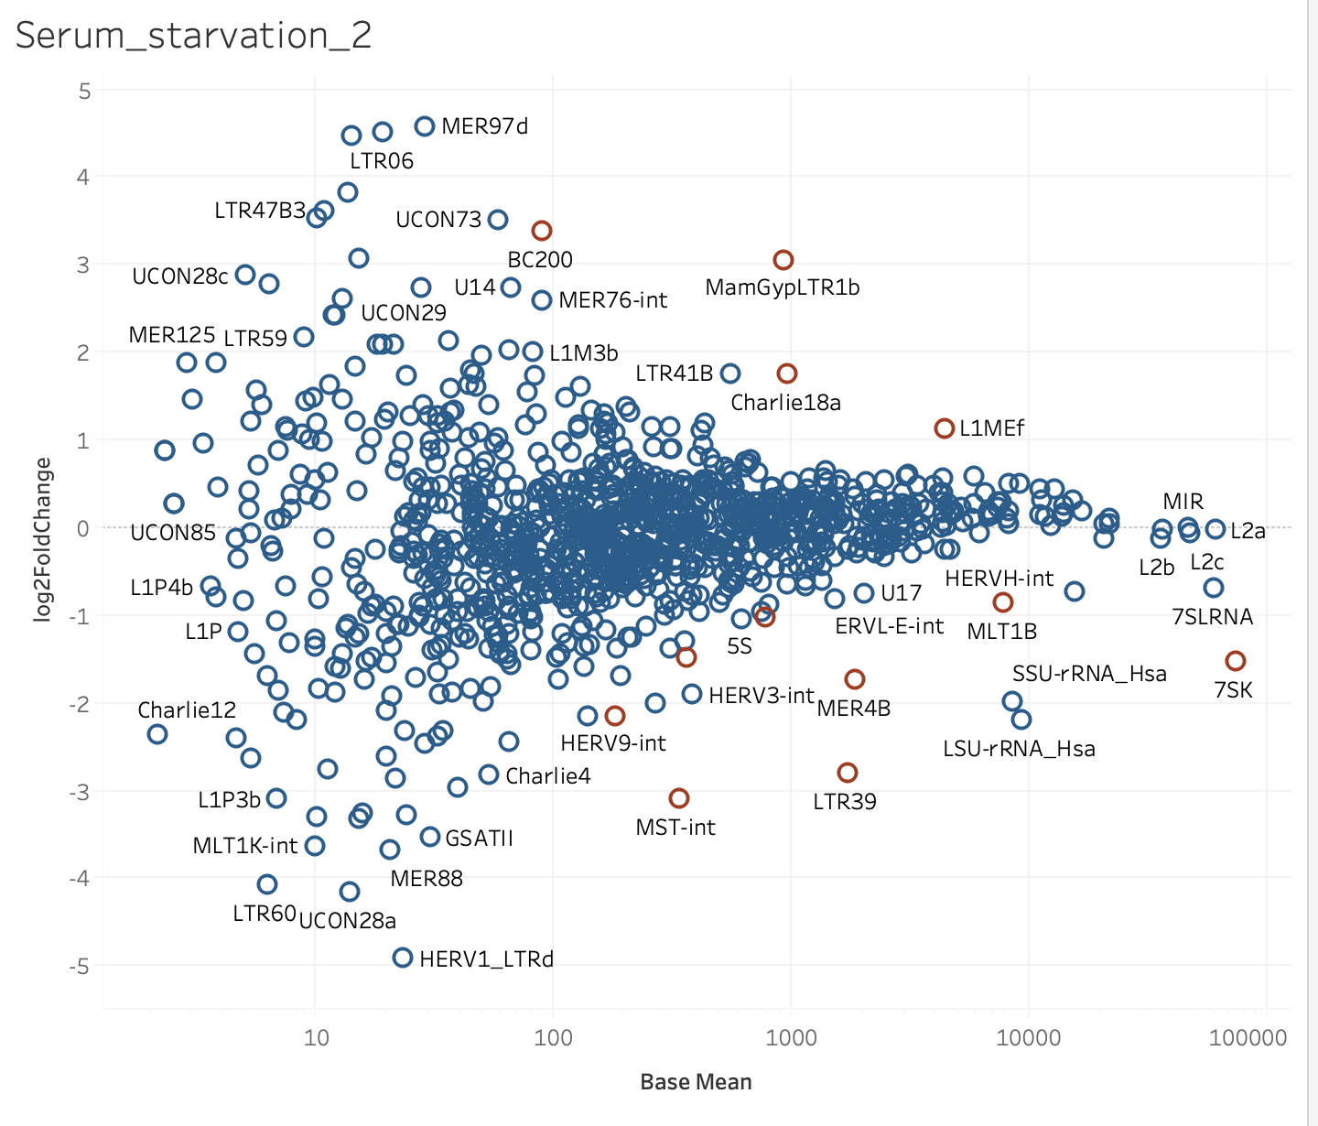
MA plots generated for each comparison

Slide 17
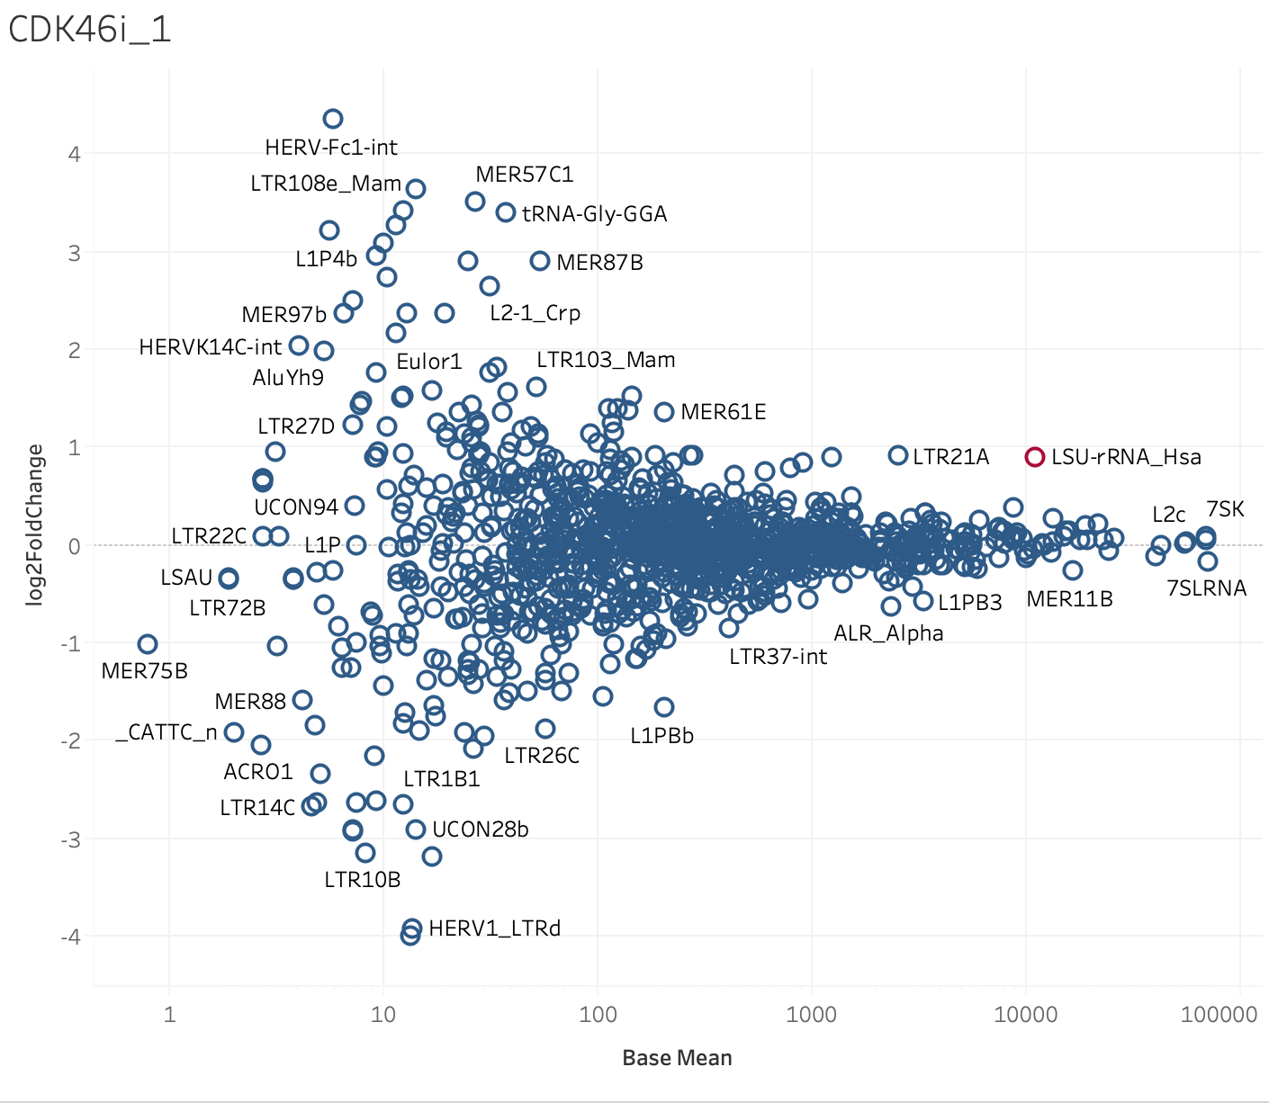
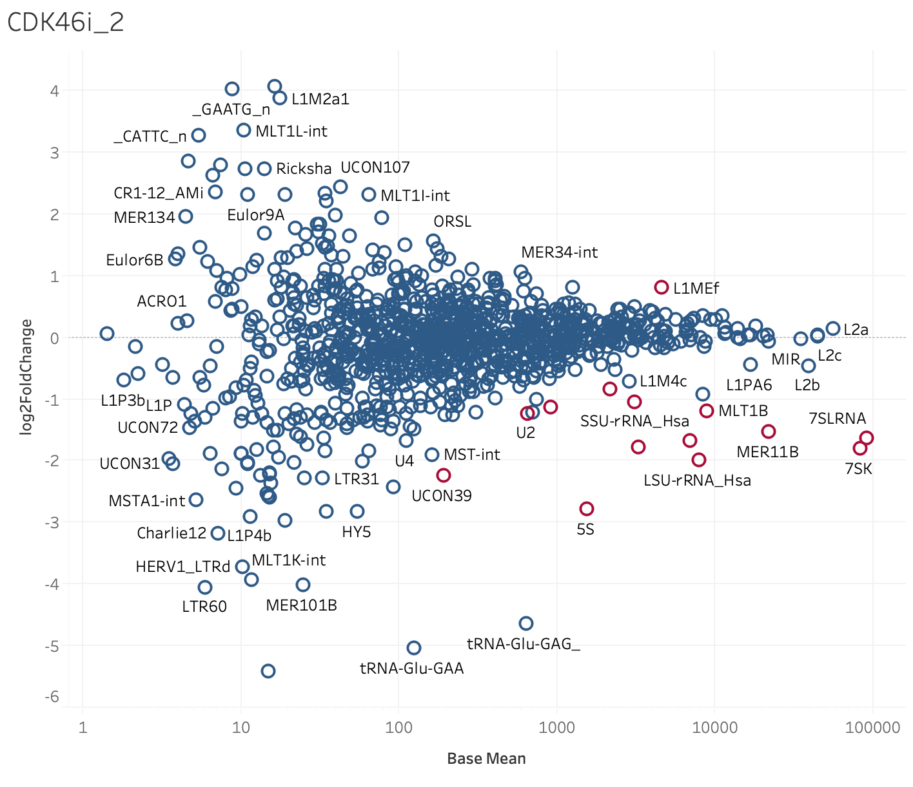
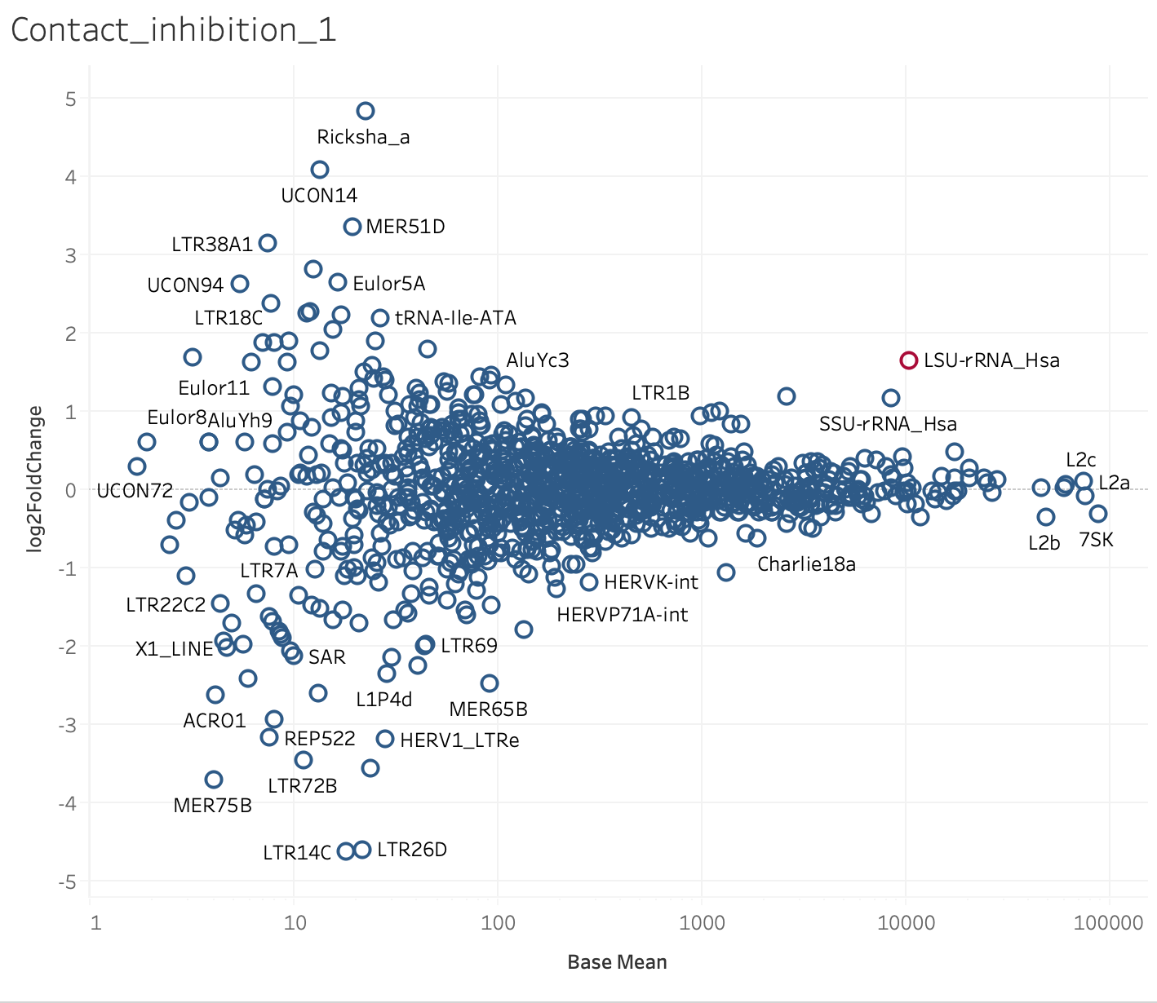
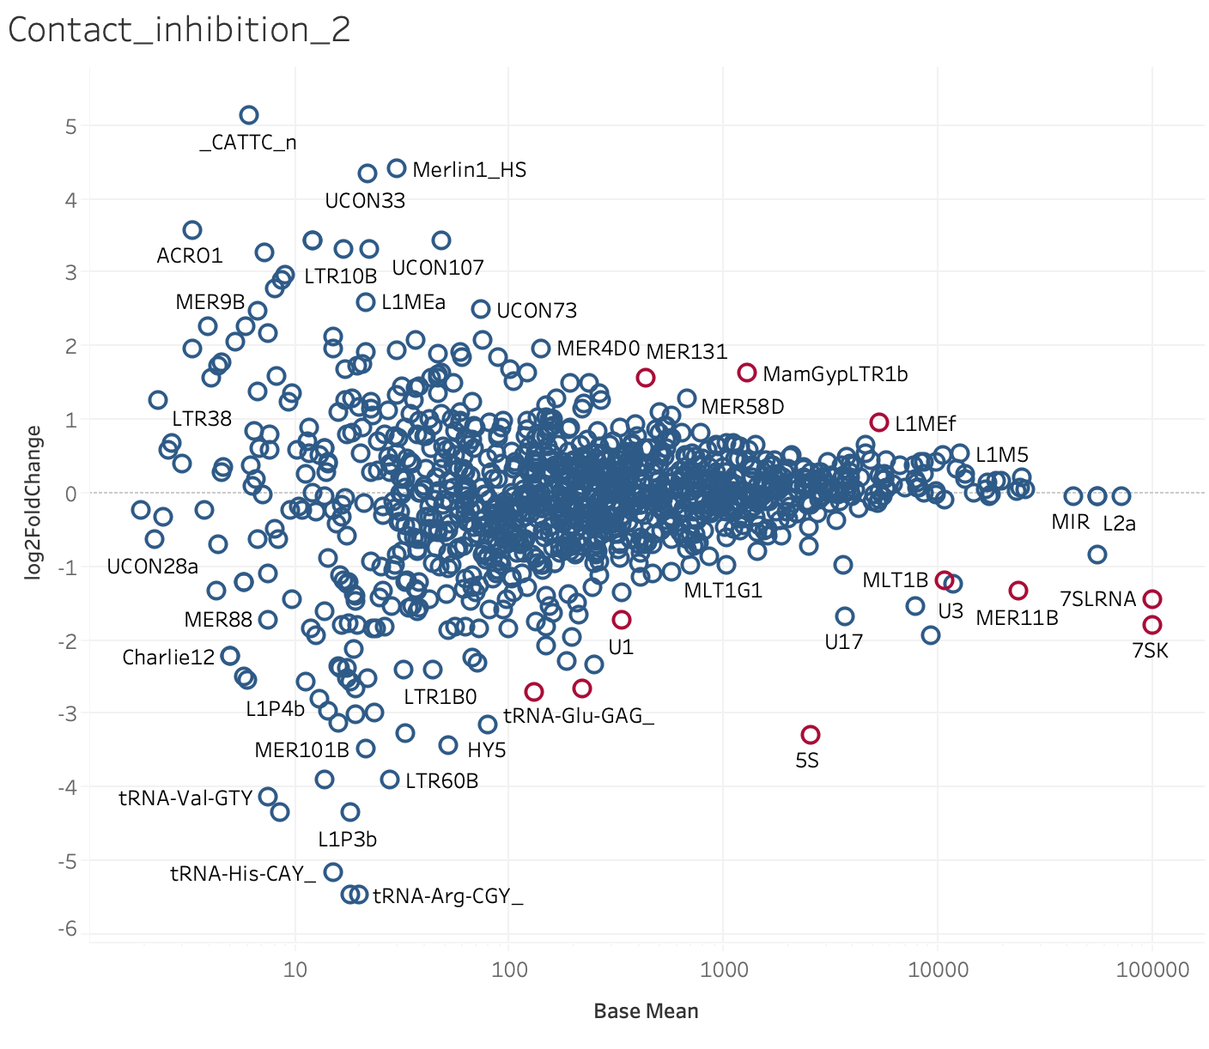
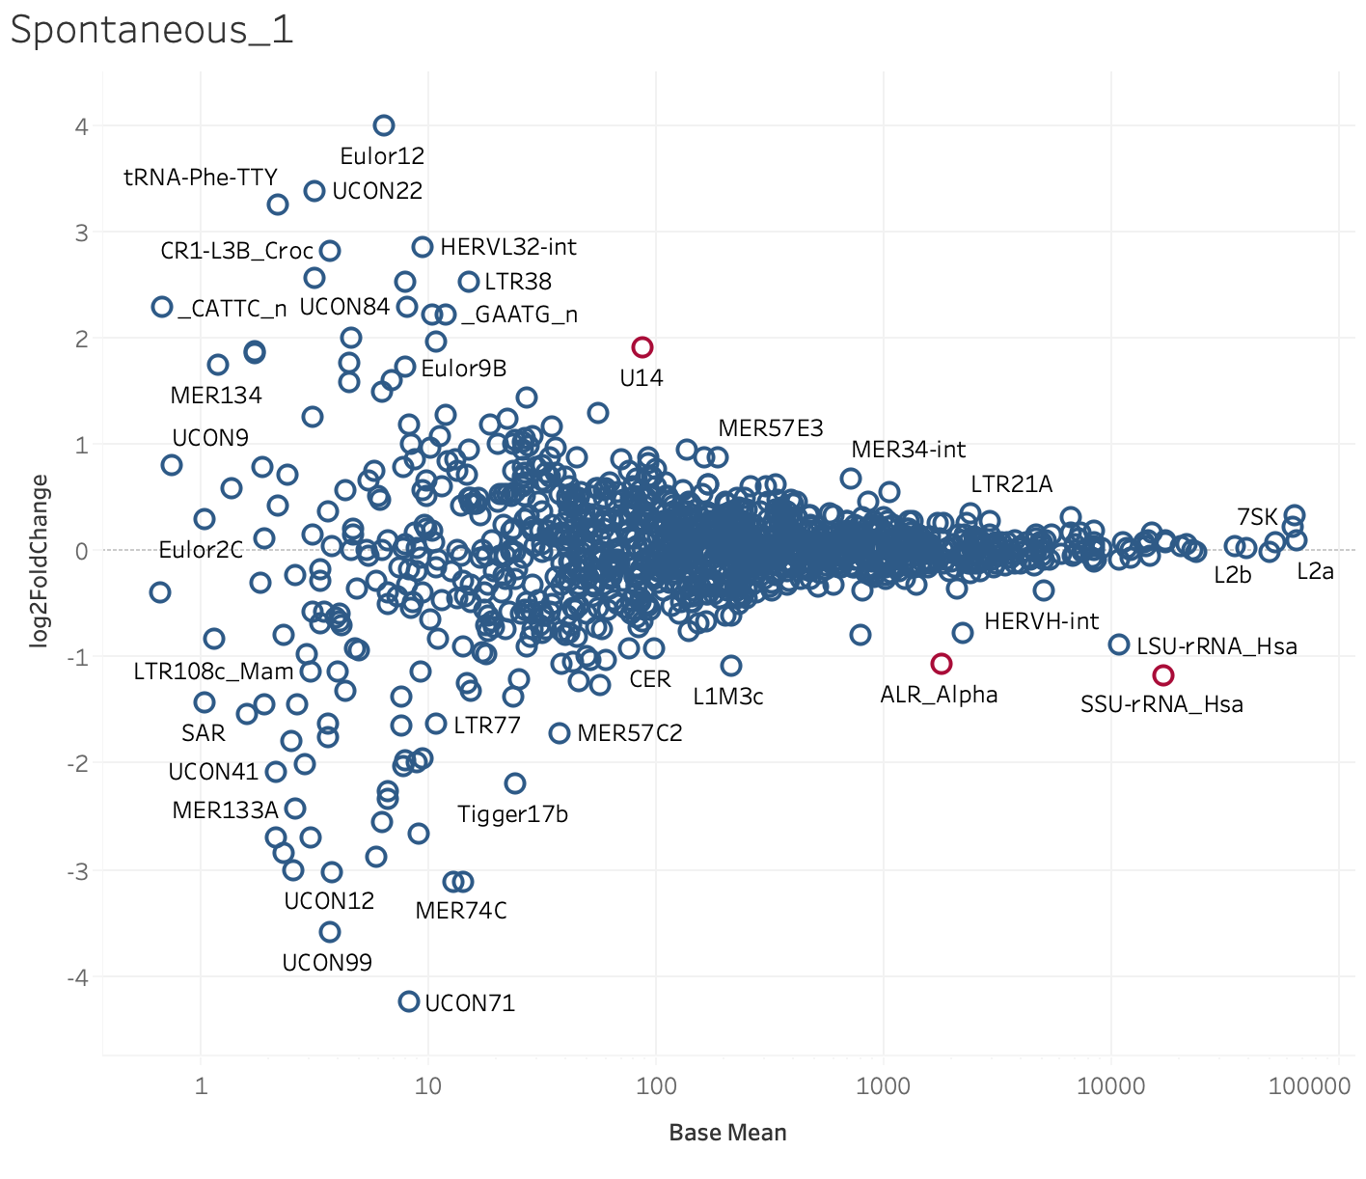
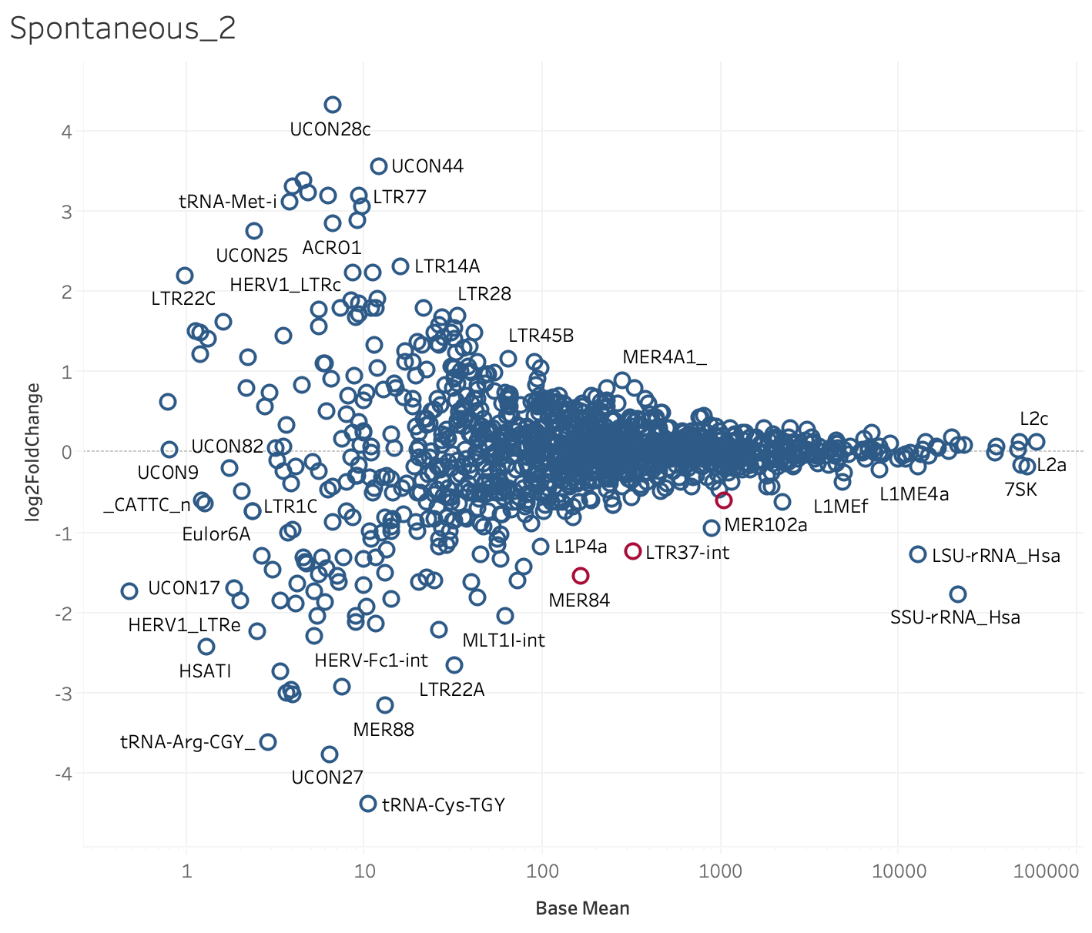
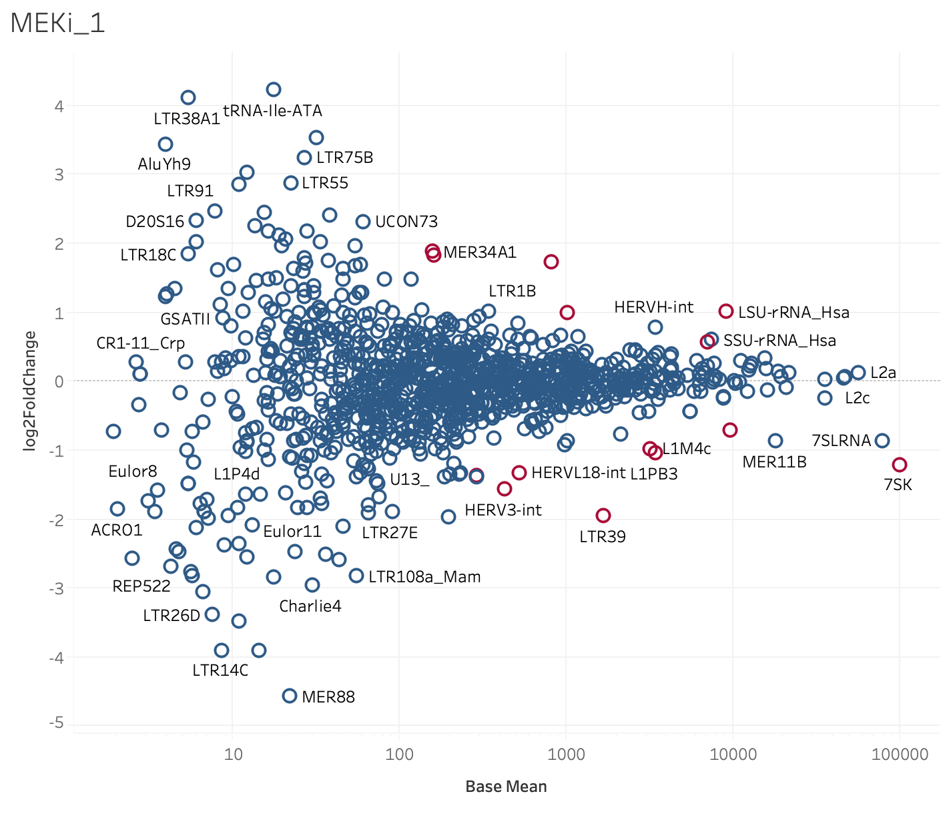
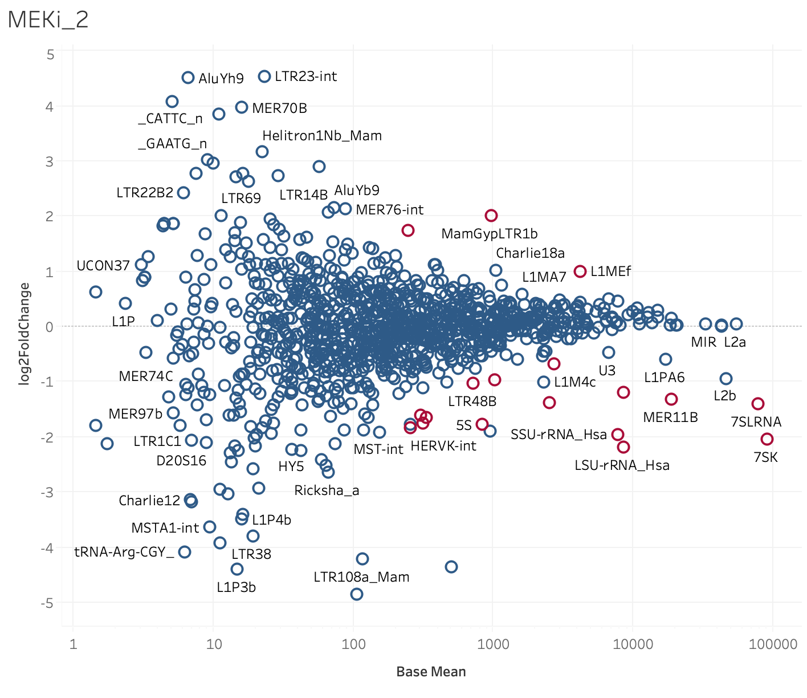
MA plots (generated for all 10 comparisons)

Slide 18
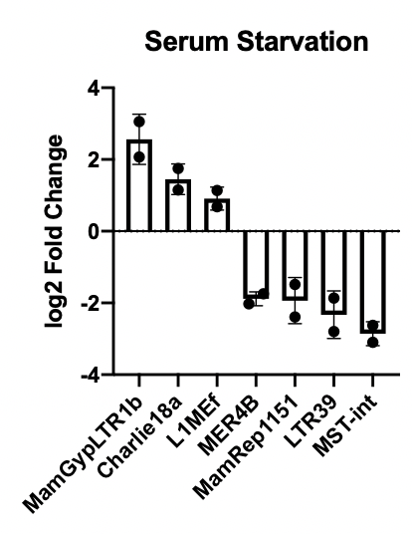
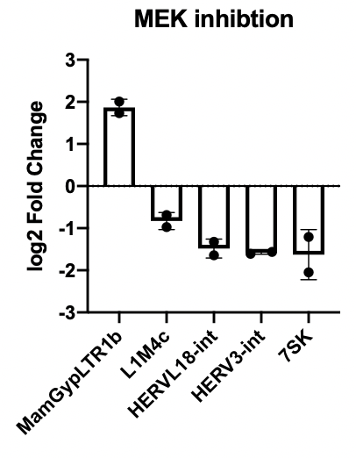
Repetitive elements that changed

Slide 19
Repetitive elements that changed

Slide 20
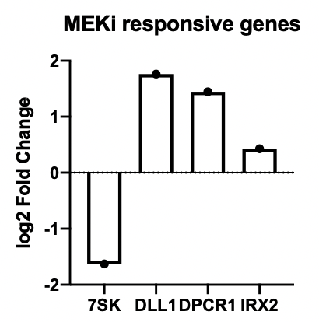
mRNAs negatively regulated by 7SK are increased in MEKi
DLL1,
IRX2,
DPCR1
7SK
What role does 7SK have in quiescence during MEKi?
Castelo-Branco, Gonçalo, Paulo P. Amaral, Pär G. Engström, Samuel C. Robson, Sueli C. Marques, Paul Bertone, and Tony Kouzarides. “The Non-Coding SnRNA 7SKcontrols Transcriptional Termination, Poising, and Bidirectionality in Embryonic Stem Cells.” Genome Biology 14, no. 9 (September 17, 2013): R98. https://doi.org/10.1186/gb-2013-14-9-r98.

Slide 21
Follow up experiments
Confirm if sequencing is real: 7SK and MamGypLTR1b in MEKi cells
qRT-PCR
Fluorescence in situ hybridization (FISH)
More thoroughly investigate retrovirus reactivation with Tetranscripts
Look at repetitive elements in other forms of stress (hypoxia, heat, etc.)

Slide 22
Questions?
Notes:
_____ will do this slide

